Slide 1
Targeting Mac1 Domain
SARS-CoV-2 Nsp3 Inhibitor Hit to Lead Proposal
Cheng Hu
April 12, 2024

Slide 2
Outline
Binding site overview
Interaction hotspots revealed by fragment co-crystallization
Adenosine site: adenine, oxyanion, lower subsite
Catalytic site and phosphate tunnel
Hits review
Hit to lead SAR mapping proposal (scaffold/compound designs)
Pocket informed
ADMET informed
Chemistry informed
Assay preparations and project planning for hit to lead campaign

Slide 3
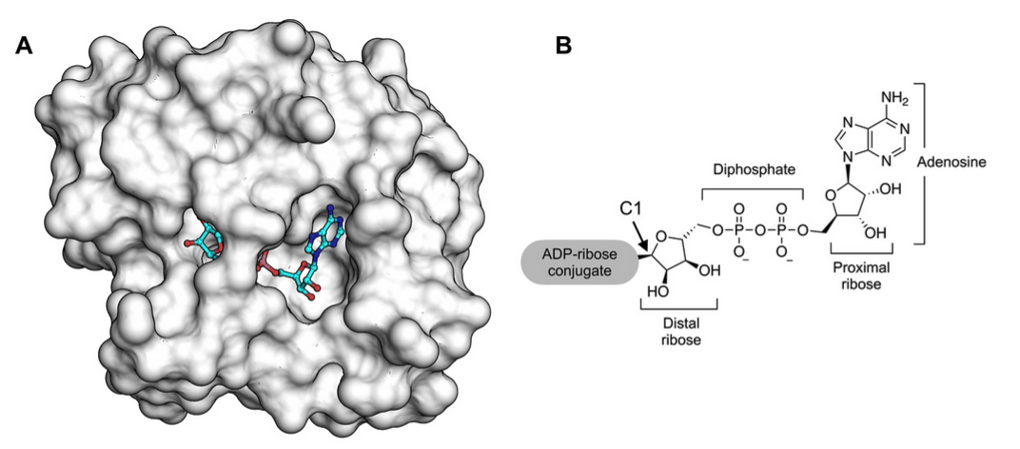
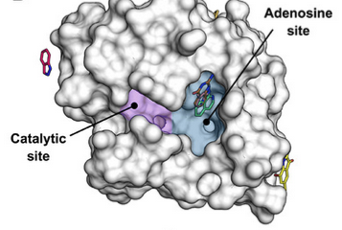
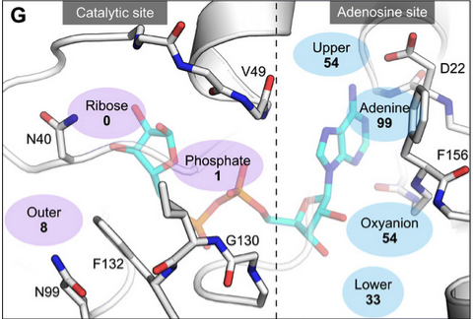
Binding Site Overview
ADPr pocket is T-shaped with the adenosine site and catalytic site connected through phosphate tunnel

Slide 4
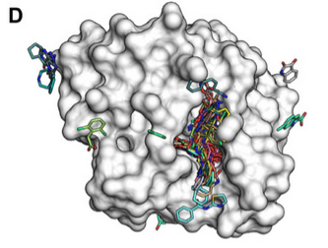
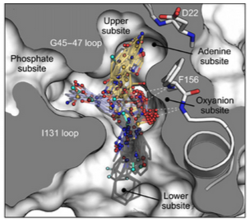
Where the Fragments Bind
Most fragments (>99%) bind to adenosine pocket:
Adenine subsite (99)
Oxyanion subsite(45)
Lower subsite (33)
Some fragments extend toward phosphate subsite
Oxyanion subpocket is the central location of T-shaped pocket
A hit2lead scaffold should have established contact in the oxyanion subpocket and can extend toward adenosine subsite, lower subsite and phosphate tunnel subsite

Slide 5
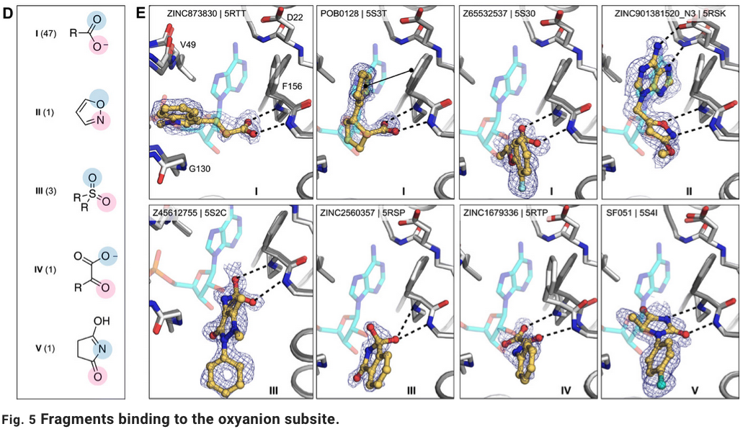
Oxyanion Subsite Binding Fragments
A variety of functional groups form bidentate interactions with backbone NH of both F156 and D157

Slide 6
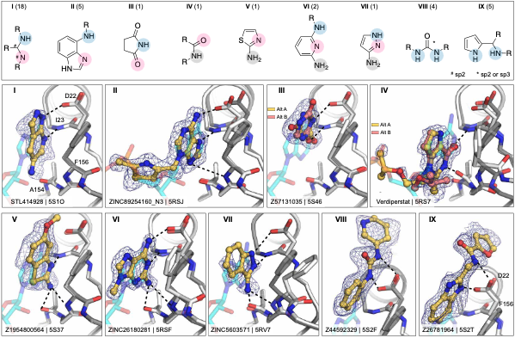
Adenine Subsite Binding Fragments
A variety of functional groups form bidentate interaction with D22 carboxylate and backbone NH

Slide 7
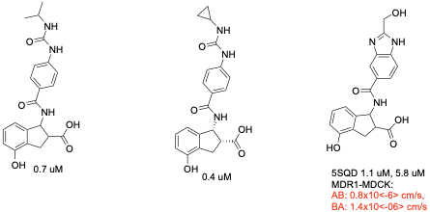
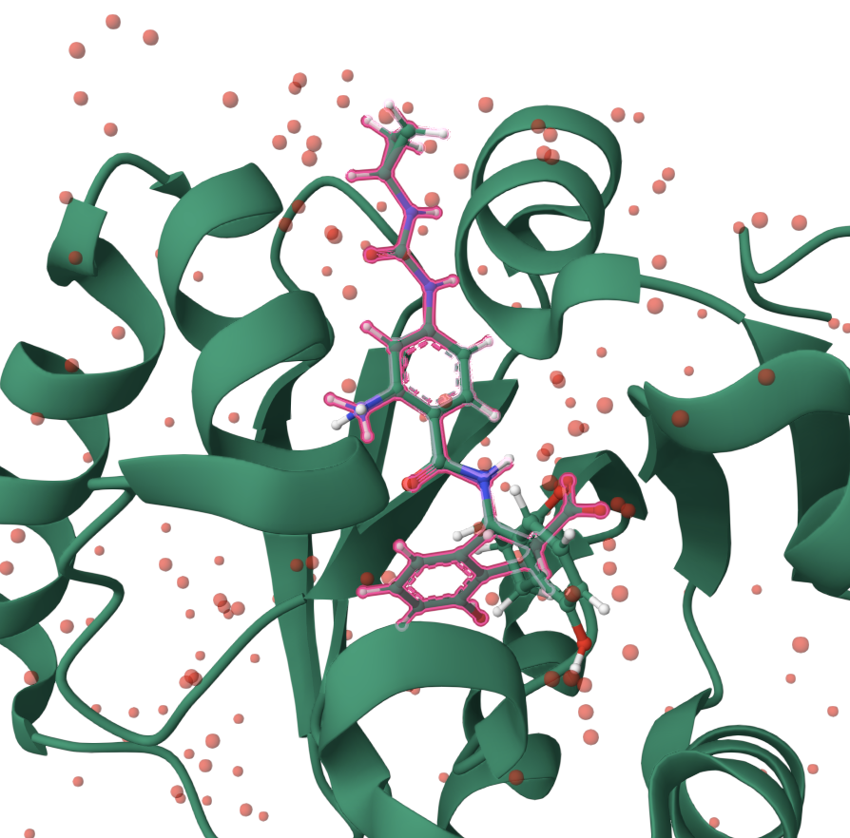
Hits Review - dihydro-indene-carboxylic acid
Urea forms bidentate interaction with COOH of D22
Carboxylate forms bidentate interaction with backbone of F156, D157
Pheny extends to diphosphate tunnel with phenol group form H-bond with backbone of L126
SAR and co-crystal structure suggest T-shaped molecules can drive potency;
Poor permeability and low LE (0.28) prevents further development of this series

Slide 8
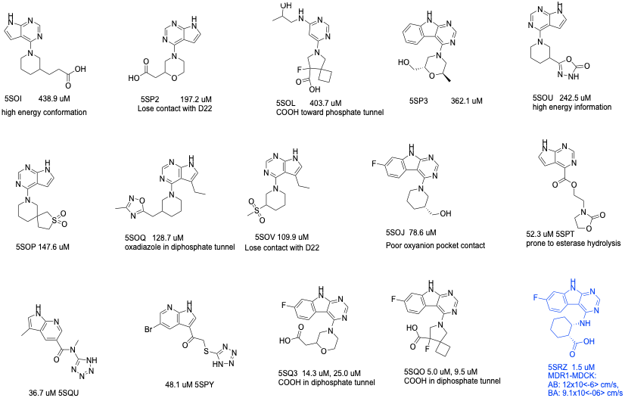
Hits Review - Pyrrolopyrimidine
No concurrent interaction with adenine subsite and oxyanion subsite observed for most hits from pyrrolopyrimidine series
5SRZ reveals concurrent interactions with adenine and oxyanion subsites

Slide 9
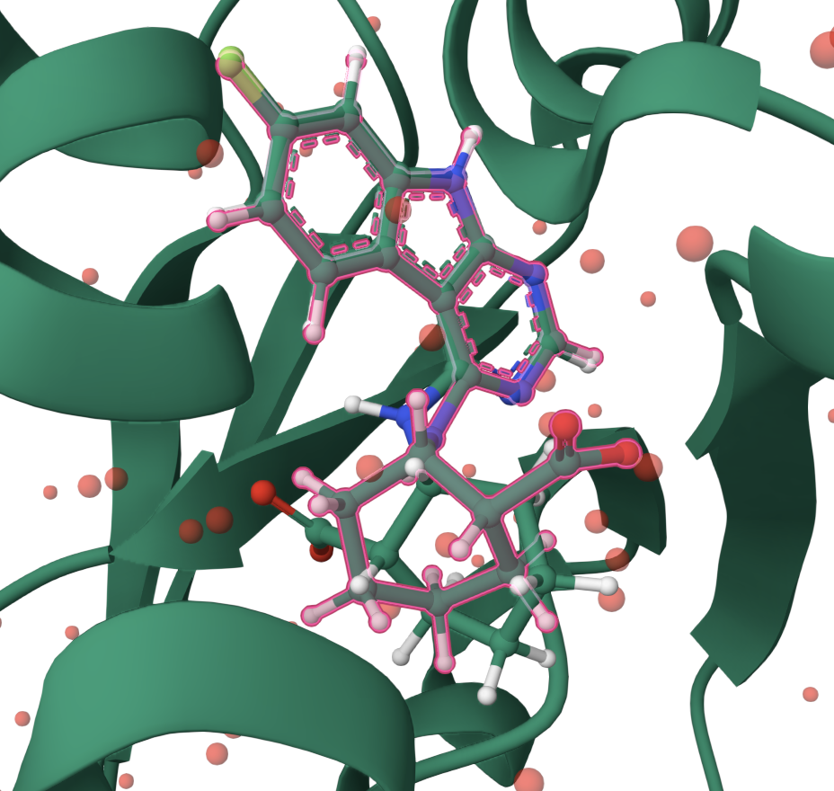
Hits Review - Pyrrolopyrimidine
D22 interaction (residue and backbone NH)
F156, D157 backbone interaction
LRH-0021
LRH-0021 form hotspot interactions in the oxyanion subsite and adenine subsite
Reasonable LE (0.32) and good permeability
Adenine subsite optimization is straightforward with SNAr chemistry
Carboxylic acid may be replaced by other oxyanion-like groups (heterocycles)
SAR exploration into phosphate tunnel is challenging (three stereocenters, trisubstituted cyclohexyl synthesis is lengthy and not amenable for SAR exploration

Slide 10
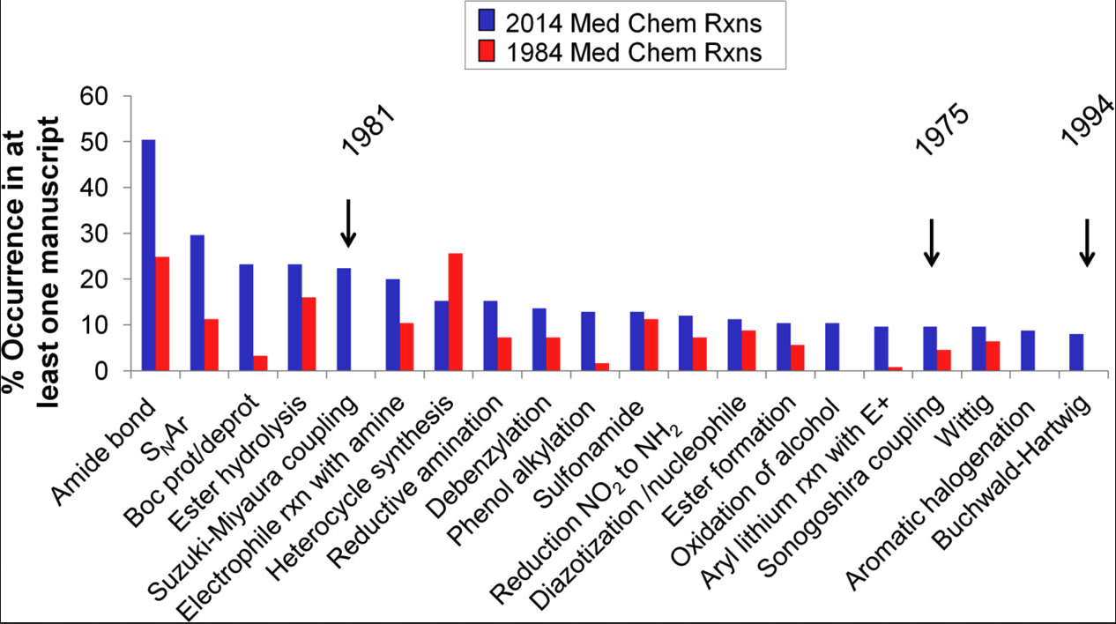
Reactions for Medicinal Chemistry
Analysis of Past and Present Synthetic Methodologies on Medicinal Chemistry
D.G.Brown et al. J. Med. Chem. 2016, 59, 10, 4443–4458
During hit2lead, it is desirable to generate chemical matters quickly utilizing commercial building blocks and employing commonly used reactions

Slide 11
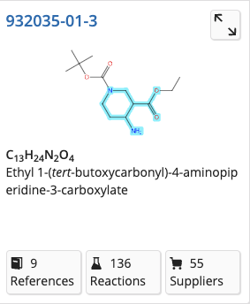
SAR Plan - Exploring Phosphate Tunnel
Change the core from cyclohexyl to piperidine enables quick SAR mapping in the phosphate tunnel
Reductive amination, amide coupling, and SNAr/Buchwald reactions are among the most commonly used reactions in medicinal chemistry

Slide 12
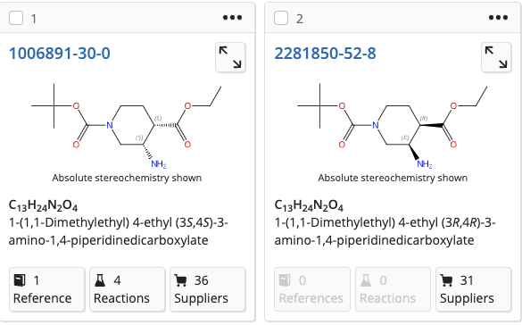
SAR Plan - Exploring Phosphate Tunnel
Change the core from cyclohexyl to piperidine enables quick SAR mapping in the phosphate tunnel
Aldehyde/ketone, carboxylic acids and Aryl halides are the most abundant building blocks for medicinal chemistry

Slide 13
SAR Plan - Explore Adenine Subsite
Explore Adenine subsite SAR with SNAr reactions
SAR obtained may transferred to new and optimized scaffolds

Slide 14
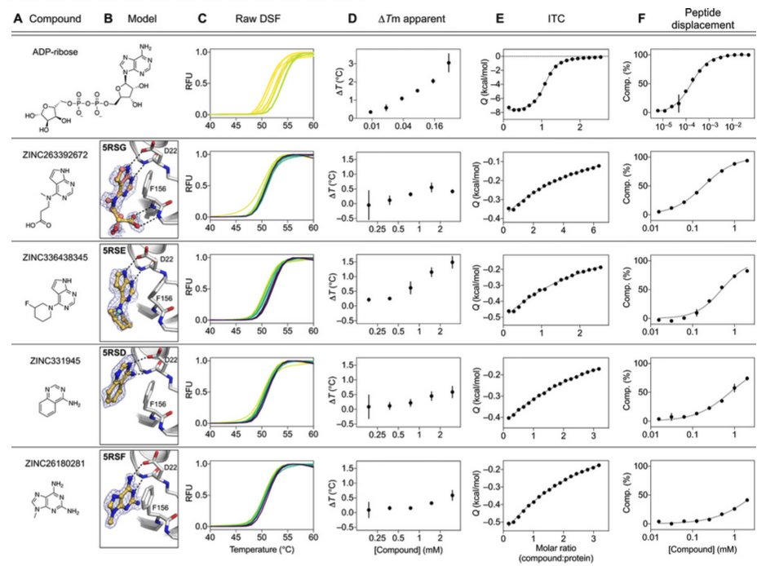
Hits from FBS
Pyrrolopyrimidine hits (-672 and -345) demonstrated activities in both biochemistry and biophysics assays
Both compounds are suitable as starting points for hit2lead campaign

Slide 15
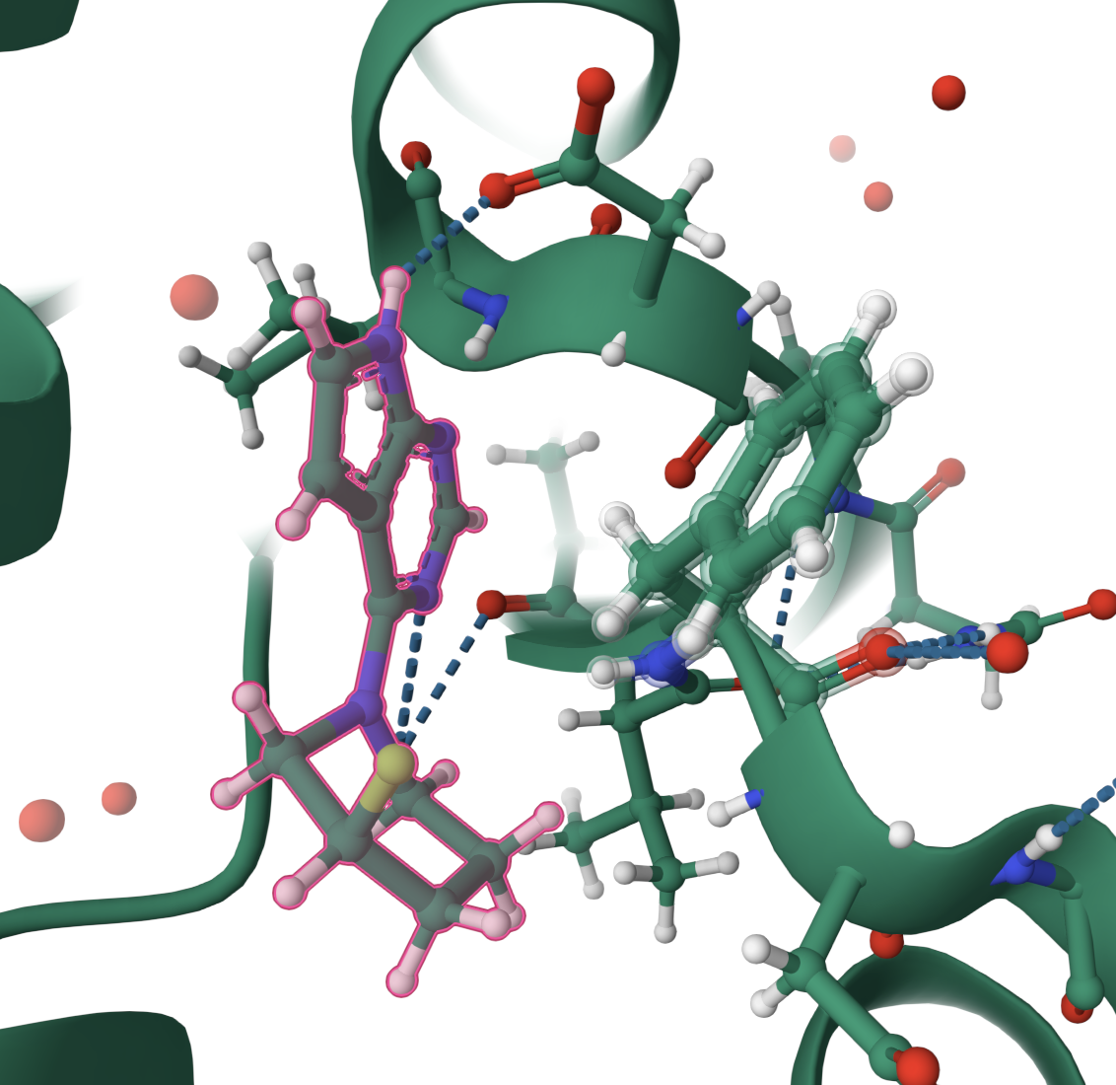
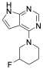
Hits From FBS - Pyrrolopyrimidine
F156 backbone NH
F157 backbone NH
ZINC336438345
IC50=180 uM
LE: 0.41
PDB code: 5RSE
Pyrrolopyrimidine forms bidentate interactions with D22
Piperidine provides the scaffold for oxyanion pocket and phosphate tunnel exploration
Can we access oxyanion subpocket from C2 of piperidine?

Slide 16
SAR Plan - Exploring Oxyanion Subsite
Designs to explore oxyanion subsite from C-2 of piperidine core

Slide 17
SAR Plan - Exploring Oxyanion Subsite
Examples of commercially available building blocks to explore oxyanion subsite:
Explore oxyanion pocket utilizing commercially available building blocks

Slide 18
SAR Plan - Extending Toward Phosphate Tunnel
Use 2,5-disubstituted piperidine to explore both oxyanion subsite and phosphate tunnel subsite

Slide 19
Hit2Lead SAR Plan Wrap Up
Proposed some examples of hit to lead SAR mapping plan based on current hits
Docking should be performed during the review process; Flexible docking is preferred as backbone movement of up to 2.0 angstrom was observed in the adenosine site
A group brainstorming exercise should generate more/better ideas for docking/review
Application of ADMET prediction model can exclude designs that are predicted to have poor solubility, poor permeability or poor stability (HLM)
GenerativeAI (pocket informed, ADMET informed and chemistry informed) should be explored.

Slide 20
Assay Preparations and Project Planning for Hit to Lead
Kinase selectivity needs to be monitored (pyrrolopyrimidine and aminopyrimidine are frequent kinase hits)
TDI monitoring (pyrrolopyrimidine moiety)
Biochemical assays (peptide displacement assay or alternative primary assays)
Cellular assays need to be established
Tier 1 ADME: Liver microsome stability (h/r/d/c), logD, kinetic solubility, MDR1-MDCK permeability (RRCK for passive permeability)
Tier 2 ADMET/PK: ratPK, CYP, hERG, AMES
PoC in animal models (timeline, compound profile)
Target candidate profile for Lead Optimization transition
Project timeline and budget

Slide 21
Thank You!

